Slide 1

Course : COMP6176 / Human - Computer Interaction
Year : 2019
COGNITIVE ASPECTS
SESSION 03

Slide 2
LEARNING OUTCOMES
• LO 1: Describe the concept of interaction
design
• LO 2: Use guidelines, principles ,models,
and framework related with interaction
design

Slide 3
OUTLINE
^{Introduction}
^{What is Cognitive}
^{Cognitive Frameworks}

Slide 4

^{INTRODUCTION}
Hafner ( 2004), a technology reporter,” distracting oneself used to consist of sharpening a half-dozen pencils or lighting a cigarette. Today, there is a universe of diversion to buy, hear, watch and forward, which makes focusing on a task all the more challenging.”
At its most extreme form, such behaviour has been found to be highly addictive : instead of focusing on our work, we’re really waiting for the next hit – be it a new email, text, Facebook posting, news feed, and so forth.

Slide 5
^{INTRODUCTION}
The study of human cognition can help to understand these and other new kinds of computer-augmented behaviours by examining human’s abilities and limitations when interacting with technologies.
Other ways of describing cognition are in terms of the context in which it takes place, the tools that are employed, the artifacts and interfaces that are used, and the people involved (Rogers, 2012)

Slide 6
^{WHAT IS COGNITION ?}
Depending on when, where, and how it happens, cognition can be distributed , situated, extended, and embodied.
There are kind of cognitive processes :
  Attention
  Perception
  Memory
  Learning
  Reading, speaking, and listening
  Problem-solving, planning, reasoning, and decision making.

Slide 7
^{WHAT IS COGNITION ?}
ATTENTION
It is the process of selecting things to concentrate on, at a point in time, from the range of possibilities available.
Attention involves auditory and visual senses.
An example of visual attention :
  Scanning the football results in a newspaper to attend to information about how our team has done.
The extent to which this process is easy or difficult depends on :
  the clear goals
  the way information is displayed can influence how easy or difficult

Slide 8


^{WHAT IS COGNITION ?}
ATTENTION
Example : Two different ways of structuring the same information at the interface Figure 03.01a more easier to find information than Figure 03.01b
(a)
(b)
Figure 03.01 Two different ways at the interface

Slide 9
^{WHAT IS COGNITION ?}
ATTENTION
Multitasking and Attention
A main finding of research on the effects of multitasking on memory and attention is :
  it depends on the nature of the tasks and how much attention each demands.
  For example : listening to gentle music while working can help people tune out background noise, such as traffic or other people talking, and help them concentrate on what they are doing

Slide 10
^{WHAT IS COGNITION ?}
ATTENTION
  However if the music is loud, like Drum and Bass, it can be very distracting.
Design Implication for Attention
  Make information salient when it needs attending to at a given stage of a task.
  Use techniques like animated graphics, colour, underlining, ordering of items, sequencing of different information, and spacing of item to achieve this.
  Avoid cluttering the interface with too much information.
  Search engines and form fill-ins that are simple are much easier to use. (Ex: Google)

Slide 11
^{WHAT IS COGNITION ?(Your turn)}
DILEMMA
Is It OK to Use a Phone While Driving?

Slide 12
^{WHAT IS COGNITION ?}
PERCEPTION
How information is acquired from the environment via the different senses organs – eyes, ears, fingers and transform into experiences of objects , event, sounds, and tastes (Roth,1986).
Involving other cognitive processes such as memory, attention, and language.
Vision is the most dominant sense for sighted individuals, followed by hearing and touch.
A general design principle is that :
  Information needs to be represented in an appropriate form to facilitate the perception and recognition of its underlying meaning.

Slide 13
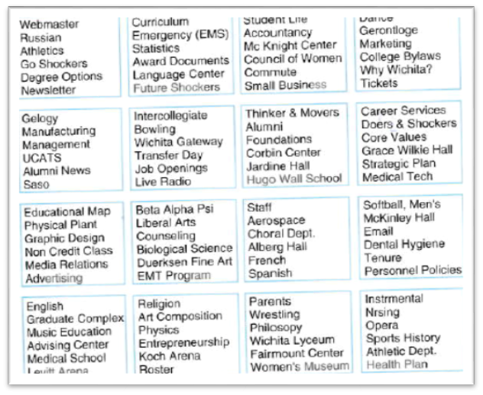
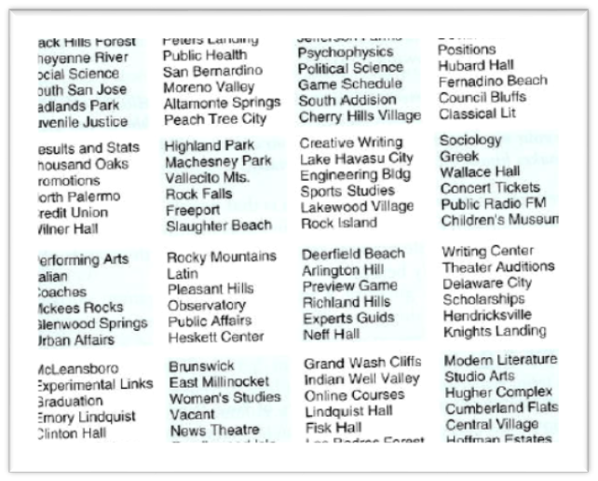
^{WHAT IS COGNITION ?}
PERCEPTION
In a study comparing web pages displaying the same amount of information, but which were structured using different graphical methods, it was found that people took less time to locate items from information that was grouped using a border (Figure a) than when using colour contrast (Figure b)
(a) Grouped using a border
(b) Grouped using color contrast

Slide 14
^{WHAT IS COGNITION ?}
PERCEPTION
Design Implication for Perception :
  Representations of information need to be designed to be perceptible and recognizable across different media :
    icons and other graphical representations should enable users to readily distinguish their meaning.
    Bordering and spacing are effective visual ways of grouping information that makes it easier to perceive and locate items.
    Sound should be audible and distinguishable

Slide 15
^{WHAT IS COGNITION ?}
PERCEPTION
    Speech output should enable users to distinguish between the set of spoken words and understand the meaning.
    Text should be legible and distinguishable from the background
    Tactile feedback used in virtual environments should allow user to recognize the meaning of the various touch sensations being emulated.

Slide 16
^{WHAT IS COGNITION ?}
MEMORY
Memory involves recalling various kinds of knowledge that allow us to act appropriately.
Example : it allows us remember someone’s name
It is not possible to remember everything that we see, hear, taste, smell, or touch .
A filtering process is used to decide what information gets further processed and memorized.

Slide 17
^{WHAT IS COGNITION ?}
MEMORY
The filtering process work :
  Initially, encoding take place determining which information is attended to in the environment and how it is interpreted.
  The extent to which it takes place affects our ability to recall that information later.
  The more attention that is paid to something and the more it is processed in term of thinking about it and comparing it with other knowledge, the more likely it is to be remembered.

Slide 18
^{WHAT IS COGNITION ?}
MEMORY
Another factor that affects the extent to which information can be subsequently retrieved is the context in which it is encoded.
Sometimes it can be difficult for people to recall information that was encoded in a different context from the one they are currently in.
Another memory phenomenon is that people are much better at recognizing things than recalling things.
In particular, people are very good at recognizing thousands of pictures even if they have only seen them briefly before.

Slide 19
^{WHAT IS COGNITION ?}
MEMORY
Another factor that affects the extent to which information can be subsequently retrieved is the context in which it is encoded.
Sometimes it can be difficult for people to recall information that was encoded in a different context from the one they are currently in.
Another memory phenomenon is that people are much better at recognizing things than recalling things.
In particular, people are very good at recognizing thousands of pictures even if they have only seen them briefly before.

Slide 20
^{WHAT IS COGNITION ?}
MEMORY
Design Implications for Memory
  Do not overload users’ memories with complicated procedures for carrying out tasks.
  Design interfaces that promote recognition rather than recall by using menus, icons and consistently placed objects.
  Provide users with a variety of ways of encoding digital information ( e.g. Files, emails, images) to help them remember where they have stored them, through the use of categories, color, flagging, time stamping, icons, etc.

Slide 21
^{WHAT IS COGNITION ?}
LEARNING
Learning can be considered in terms of :
  How to use a computer based application
  Using a computer-based application to understand a given topic.
A main observation is that people find it very hard to learn by following a set of instructions in a manual.
Instead , they much prefer to learn through doing.
GUIs and Direct Manipulation interfaces are good environments for supporting this kind of active learning by supporting exploratory interaction and allowing users to undo their actions.

Slide 22
^{WHAT IS COGNITION ?}
LEARNING
Learning can be considered in terms of :
  How to use a computer based application
  Using a computer-based application to understand a given topic.
A main observation is that people find it very hard to learn by following a set of instructions in a manual.
Instead , they much prefer to learn through doing.
GUIs and Direct Manipulation interfaces are good environments for supporting this kind of active learning by supporting exploratory interaction and allowing users to undo their actions.

Slide 23
^{WHAT IS COGNITION ?}
LEARNING
One of the main benefits of interactive technologies such as web-based learning, multimedia and virtual reality is :
  they provide alternative ways of representing and interacting with information that are not possible with traditional technologies e.g. books.
The interactive technologies have the potential of offering learners the ability to explore ideas and concepts in different ways.
E.g. interactive multimedia simulations have been designed to help teach abstract concepts( e.g. Mathematical formulae) that students find difficult to grasp.

Slide 24
^{WHAT IS COGNITION ?}
LEARNING
Design Implication for Learning
  Design interfaces that encourage exploration
  Design interfaces that constrain and guide users to select appropriate actions when initially learning.
  Dynamically link concrete representations and abstract concepts to facilitate the learning of complex material.

Slide 25
^{WHAT IS COGNITION ?}
READING, SPEAKING, AND LISTENING
Reading, speaking and listening are three forms of language processing that have similar and different properties.
One similarity is that the meaning of sentences or phrases is the same regardless of the mode in which it is conveyed.
The ease with which people can read, listen, or speak differs depending on the person, task, and context.
Specific differences between the three modes include :

Slide 26
^{WHAT IS COGNITION ?}
READING, SPEAKING, AND LISTENING
Specific differences between the three modes include :
  Written language is permanent while listening is transient.
  Reading can be quicker than speaking or listening , as written text can be rapidly scanned in ways not possible when listening to serially presented spoken words.
  Listening requires less cognitive effort than reading or speaking.
  Written language tends to be grammatical while spoken language is often ungrammatical.
  Dyslexics have difficulties understanding and recognizing written words, making it hard for them to write grammatical sentences and spell correctly.

Slide 27
^{WHAT IS COGNITION ?}
READING, SPEAKING, AND LISTENING
Many application have been developed to capitalize on people’s reading, writing, and listening skills :
  Interactive books and web-based materials that help people to read or learn foreign languages.
  Speech-recognition systems that allow users to interact with them by using spoken command. (e.g. Google Voice Search app)
  Speech-output systems that use artificially generated speech
  Natural-language systems that enable users to type in questions and give text-based responses. (e.g.Ask search engine)
  Cognitive aids that help people who find it difficult to read, write, and speak.

Slide 28
^{WHAT IS COGNITION ?}
READING, SPEAKING, AND LISTENING
Many application have been developed to capitalize on people’s reading, writing, and listening skills :
  Customized input and output devices that allow people with various disabilities to have access to the web and use word processors and other software packages.
  Interaction techniques that allow blind people to read graphs and other visuals on the web through the use of auditory navigations and tactile diagrams(Petrie et al, 2002).

Slide 29
^{WHAT IS COGNITION ?}
READING, SPEAKING, AND LISTENING
Design Implication for Reading, Speaking and Listening
  Keep the length of speech-based menus and instruction to a minimum.
  Accentuate the intonation of artificially generated speech voices as they are harder to understand than human voices.
  Provide opportunities for making text large on a screen, without affecting the formatting, for people who find it hard to read small text.

Slide 30
^{WHAT IS COGNITION ?}
PROBLEM SOLVING,PLANNING, REASONING AND DECISION MAKING
Problem solving, planning, reasoning and decision making are processes involving reflective cognition.
They include thinking about what to do, what the options are, and what the consequences might be of carrying out a given action.
They often involve conscious processes (being aware of what on is thinking about), discussion with others ( or oneself), and the use of various kinds of artifacts (e.g.maps, books,pen,and paper).

Slide 31
^{WHAT IS COGNITION ?}
PROBLEM SOLVING,PLANNING, REASONING AND DECISION MAKING
The extent of which people engage in reflective cognition depends on their level of experience with a domain, application, or skill.
Novices tend to have limited knowledge and will often make assumptions about what to do using other knowledge about similar situations. They tend to act by trial and error, exploring and experimenting with ways of doing things.
The Experts have much more knowledge and experience and able to select optimal strategies for carrying out their tasks.

Slide 32
^{WHAT IS COGNITION ?}
PROBLEM SOLVING,PLANNING, REASONING AND DECISION MAKING
Instead of proving ever more information to enable people to compare products when making a choice, a better strategy is to design technological interventions that provide just enough information and in the right form, to facilitate good choices.
One solution is to exploit new forms of augmented reality technology that enable information-frugal information decision making. ( Rogers et all,2010).

Slide 33
^{WHAT IS COGNITION ?}
PROBLEM SOLVING,PLANNING, REASONING AND DECISION MAKING
Design implication for problem solving, planning, reasoning, and decision making :
  Provide additional hidden information that is easy to access for users who wish to understand more about how to carry out an activity more effectively. ( e.g. Web searching).
Use simple and memorable functions at the interface for computational aids intended to support rapid decision making and planning that takes place while on the move

Slide 34
^{COGNITIVE FRAMEWORKS}
There are three early internal frameworks that focus primarily on mental processes together with three more recent external ones that explain how human interact and use technologies in the context in which they occur . They are :
Internal | External
Mental Models | Distributed cognition
Gulfs of execution and evaluation | External cognition
Information Processing | Embodied interaction

Slide 35
^{COGNITIVE FRAMEWORKS}
Mental Models
  People primarily develop knowledge of how to interact with a system, and to la lesser extent , how that system works.
  The more someone learns about a system and how it functions, the more their mental model develops.
  If people could develop better mental models of interactive systems they would be in a better position to know how to carry out their task efficiently and know what to do if a system started malfunctioning.
  If interactive technologies could be designed more transparent then it might be easier to understand in term of how they work and what to do when they don’t.

Slide 36
^{COGNITIVE FRAMEWORKS}
Mental Models
  Transparency involves including :
    Useful feedback in response to user input
    Easy to understand and intuitive ways of interacting with the system
  Providing the right kind and level of information in the form of :
    Clear and easy-to-follow instructions
    Appropriate online help and tutorials and Context-sensitive guidance for users.
    Background information that can be accessed to let people know how something works and how to make the most of the functionality provided.
    Affordances of what actions an interface allows (for example, swiping, clicking, or selecting).

Slide 37
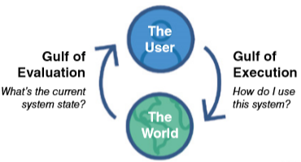
^{COGNITIVE FRAMEWORKS}
b. Gulfs of Execution and Evaluation
  The gulfs of execution and the gulf of evaluation describe the gaps that exist between the user and the interface (Norman,1986;Hutchin et al 1986).
  The gulfs of execution describe the distance from the user to the physical system
  The gulfs of evaluation describe the distance from the physical system to the user. (Figure 03.01)
Figure 03.01 Bridging the gulfs of execution and evaluation

Slide 38
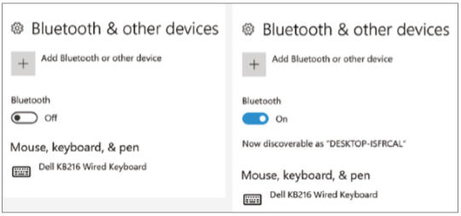
^{COGNITIVE FRAMEWORKS}
b. Gulfs of Execution and Evaluation
Figure 03.02 An example where the gulfs helped explain how a seemingly trivial design decision led to much user frustration

Slide 39

^{COGNITIVE FRAMEWORKS}
c. Information Processing
  Information is thought to enter and exit the mind through a series of ordered processing stages (Figure 03.03)
  The information processing model provides a basis from which to make predictions about human performance.
  One of the first HCI models to derived from the information processing theory was the human processor model, which modeled the cognitive processes of a user interacting with a computer (Card et al, 1983).
Figure 03.03 Human Information Processing Model

Slide 40
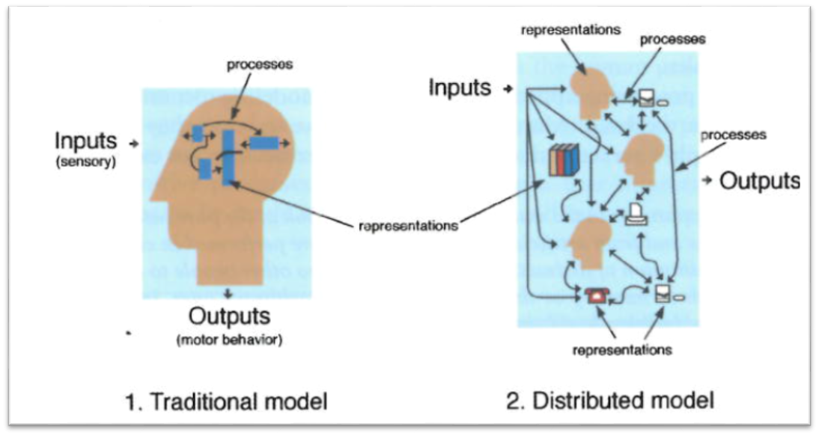
^{COGNITIVE FRAMEWORKS}
d. Distributed Cognition
  The distributed cognition studies the nature of cognitive phenomena across individuals, artifacts, and internal and external presentation (Hutchins,1995).(See Figure 03.04)
Figure 03.04 Comparison of traditional and distributed cognition approaches

Slide 41
^{COGNITIVE FRAMEWORKS}
d. Distributed Cognition
  An example of a cognitive system is an airline cockpit, where the top-level goal is to fly the plane (see Figure 03.05). This involves all of the following:
    The pilot, captain, and air traffic controller interacting with one another.
    The pilot and captain interacting with the instruments in the cockpit
    The pilot and captain interacting with the environment in which the plane is flying (that is, the sky, runway, and so on)

Slide 42
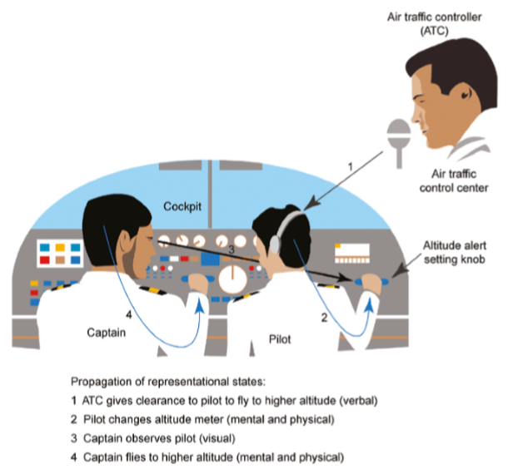
^{COGNITIVE FRAMEWORKS}
d. Distributed Cognition
Figure 03.05 A cognitive system in which information is propagated through different media

Slide 43
^{COGNITIVE FRAMEWORKS}
d. Distributed Cognition
  A primary objective of the distributed cognition approach is to describe these interactions in terms of how information is propagated through different media.
e. External Cognition
  External cognition is concerned with explaining the cognitive processes involved when we interact with different external representations (Sciafe and Rogers, 1996).
  A main goal is to explicate the cognitive benefits of using different representation for different cognitive activities and the processes involved.

Slide 44
^{COGNITIVE FRAMEWORKS}
e. External Cognition
  The main ones include :
    Externalizing to reduce memory load
    Use diaries, personal reminders, and calendar for acting as external reminders of what we need to do at a given time.
    Computational offloading
    It occurs when use a tool or device in conjunction with an external representation to help us carry out a computation.
    Example : using pen and paper to solve a math problem.

Slide 45
^{COGNITIVE FRAMEWORKS}
e. External Cognition
  The main ones include :
    Annotating and cognitive tracing
      Externalize the cognition by modifying representations to reflect changes that are taking place that wish to mark.
      Annotating involves modifying external representations such as crossing off or underlining items. Example : Tablet PC enable users to physically annotate documents such as circling data or writing notes using styluses.

Slide 46
^{COGNITIVE FRAMEWORKS}
e. External Cognition
  The main ones include :
    Annotating and cognitive tracing
      Cognitive tracing involves externally manipulating items into different orders or structures. Example : In Scrabble, where shuffling around letters in the tray helps a person work out the best word given the set of letters ( Maglio et al, 1999)
f. Embodied Interaction
  HCI which grew out of collaborations between computer scientists and psychologists, initially adopted an information processing perspective.
  Embodied interaction has been applied quite broadly to HCI, including work that focuses on the emotional quality of interaction with technology.(Hook,2008).

Slide 47
^{REFERENCES}
Interaction Design 5th Edition 2019, Chapter 4
https://www.youtube.com/watch?v=ktgnhetc8gQ
http://ir.lib.cyut.edu.tw:8080/bitstream/310901800/14308/4/c3.pdf
http://www.zainbooks.com/books/computer-sciences/human-computer-interaction_6_cognitive-frameworks.html

